Slide 1
Retrospective Open Access
with IGI Global

Slide 2
Introductions
Marissa Massare, Open Access Publishing Coordinator, IGI Global
Lindsay Wertman, President, IGI Global

Slide 3
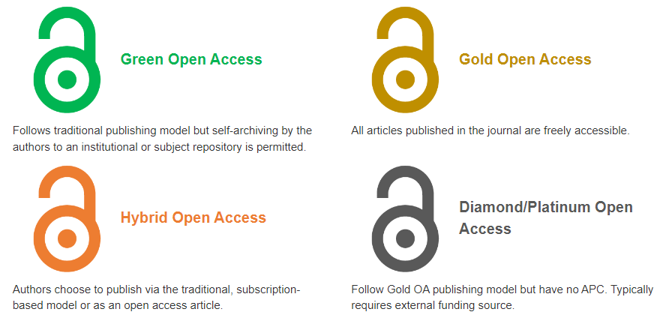
What is Open Access (OA)?
Open Access: Making peer-reviewed scholarly research (journal articles, book chapters, full books, etc.) and literature freely available online without any paywalls or login restrictions (published under Creative Commons licensing).
Common Types

Slide 4
What is Retrospective Open Access (OA)?

Slide 5
Types of Retrospective Open Access
Paper Level
Journal Articles
Book Chapters
Journals
Volume Years
Special Issues
Full Book Publications
Authored & Edited Monographs
Casebooks
Handbooks of Research
Encyclopedias

Slide 6
Benefits of Retrospective Open Access (OA)
Copyright returned to the authors (converted to CC licensing)
Content becomes free to access by all researchers around the world and can be deposited in any repository and on any website worldwide
Greater sharing power and discoverability for the authors and editors (and greater recognition for their institutions)
Higher download rates (roughly 89% more)
Increased citation rates and indexing potential
Contents of the unlocked work can be utilized in future publications and teaching materials
Opens further opportunities for additional research collaborations
Affordable open access conversion fees
Institutions funding conversions will benefit from a wide range of promotional materials highlighting the funding sponsorship

Slide 7
Dr. Sang-Bing Tsai Speaks to the Rise in Impact for His Journal: Journal of Organizational and End User Computing (JOEUC)
Case of a Successful Journal Conversion to Open Access
The journal converted to gold open access in 2021. It also retrospectively had its 2020 volume year converted to open access.
Total Cites: 304
Eigenfactor: 0.00026
Total Cites: 476
Eigenfactor: 0.00039
Total Cites: 1,003
Eigenfactor: 0.00053

Slide 8
Increasing Impact
JOEUC Conversion Success
IF
2020
IF
2021
IF
2022
1.882
4.349
7.4
JGIM Conversion Success
IF
2020
IF
2021
IF
2022
1.213
1.373
3.474

Slide 9
Overview of the Conversion Process, Pricing, and Funding

Slide 10
Retrospective Process and Funding Options
Overview of the Retrospective Conversion Process

Slide 11
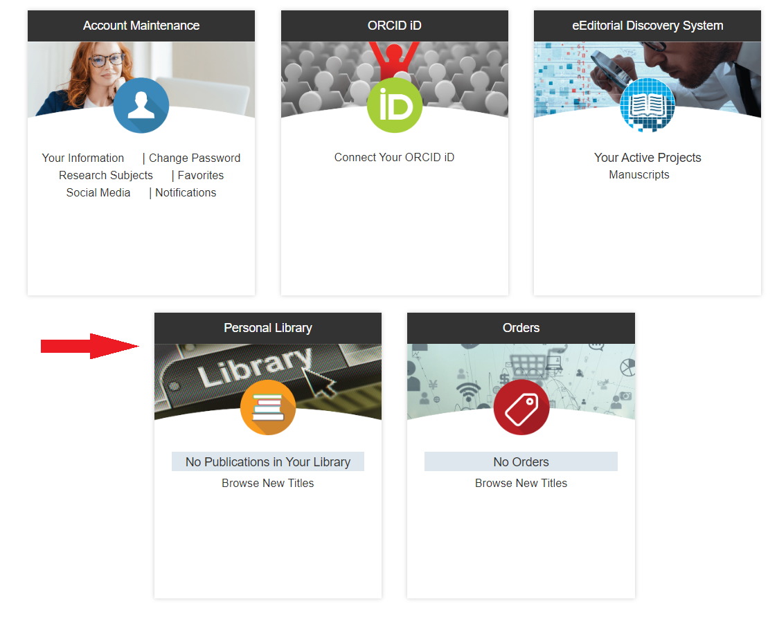
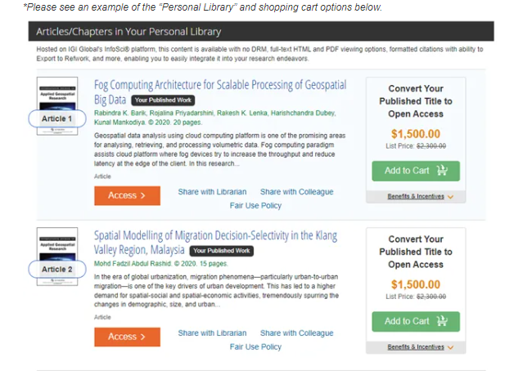
Convert via Author Portal (Individual Articles and Chapters Only)
Once in the personal library, you can select the works you want to convert to OA and add them to the shopping cart
Access your previously published work through your IGI Global Portal Personal Library

Slide 12
Average Costs to Convert Work to Open Access
Because the work will no longer be behind a paywall collecting revenue, open access processing charges ((Article Processing Charges (APCs), Chapter Processing Charges (CPCs), and Book Processing Charges (BPCs)) help support the overhead costs that went into producing the work.
Some key factors in determining pricing for works being converted include:
•The copyright or volume year in which the work was originally published •The size of the publication •Any revenue already secured for the publication (for full books) •Whether or not the cost to produce the work has been recouped
*Contributors receive an additional 20% discount off prices*
Journal Articles
Range from US $265 (lowest backlist) to US $2,500 (highest frontlist)
Book Chapters
Range from US $700 (lowest backlist) to US $2,300 (highest frontlist)
Full Books
Range from US $3,000 (lowest backlist) to US $30,000 (highest frontlist)

Slide 13
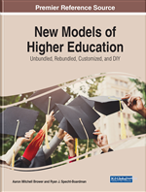
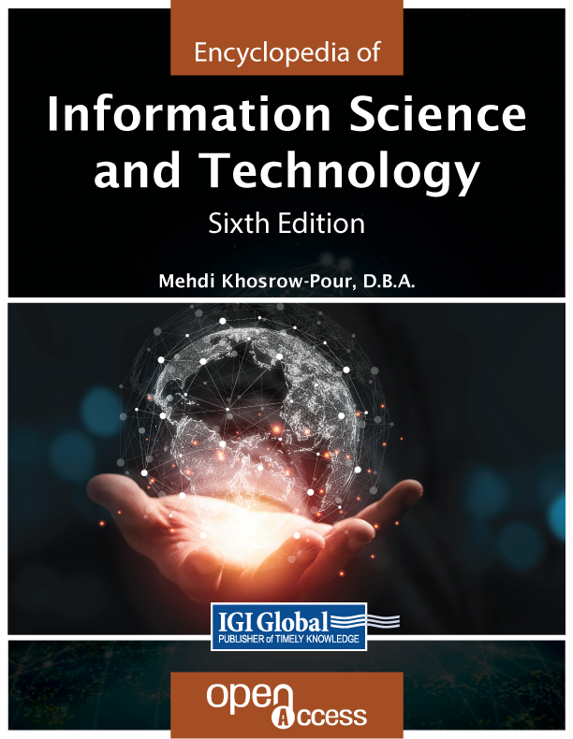
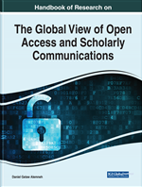
Funding Options
Funding Options

Slide 14
OA Books with IGI Global
& Successful Funding

Slide 15
agosr.com
The AGOSR Mission
AGOSR fosters an inclusive approach to the accessibility and innovation of open access research by working with publishers, librarians, and researchers worldwide to cultivate principles, share practices, and distribute open access content within the global research community.
IGI Global authors will have their open access publications automatically fed into
AGOSR’s Open Access Repository
For more information, contact AGOSR at: info@agosr.com

Slide 16
Questions?

Slide 17
Marissa Massare, Open Access Publishing Coordinator, IGI Global
mmassare@igi-global.com
Contact Us
Open Access
openaccessadmin@igi-global.com

