Slide 1
Open Access
Publishing With IGI Global

Slide 2
introductions
Marissa Massare, Open Access Publishing Coordinator, IGI Global
Lindsay Wertman, President, IGI Global
Brittany Haynes, Director of eCollections, IGI Global

Slide 3
Open Access Overview and Models

Slide 4
What is open access ?
Open access (OA) is a set of principles and practices through which research outputs, including journal articles, book chapters, and full books are distributed online, free of cost or any other access barriers.
IGI Global offers open access (OA) publishing in both scholarly journals and reference books. The OA publishing model allows for authors to have their work published and freely accessible to the research community after publication.

Slide 5
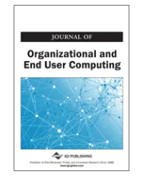
Why Choose Open access Publishing?
Freely Share Your Research
Higher Discoverability and Citation Impact
Rigorous and Expedited Publishing Process
Increased Advancement and Collaboration
OA Conversion Success Story:
JOEUC Before OA Conversion (2020) | JOEUC After OA Conversion
Impact Factor – 1.882 | Impact Factor – 7.400
2020 - Total # of Published Articles – 23 | 2021 – Total # of Published articles - 71 2022 – Total # of Published Articles – 42 so far

Slide 6
A comparison of Publishing Models
* Indicates all publishing models used by IGI Global.
Traditional Publishing:*
All articles/chapters published in the publication are only available through the purchase of or subscription to the publication.
Gold Open Access:*
All articles/chapters published in the publication are freely accessible.
Green Open Access:*
Follows traditional publishing model but self-archiving by the authors to an institutional or subject repository is permitted.
Diamond/Platinum Open Access:*
Follows Gold OA publishing model but have no APC or CPC. Typically requires external funding source.
Hybrid Open Access:*
Authors choose to publish via the traditional, subscription-based model or as an open access article or chapter.
Bronze Open Access
Freely accessible through publisher’s page, but no licensing identified. May not be available for reuse.

Slide 7
Hybrid Open Access (Journal publishing)
©
Article accepted after peer review process
Does not pay a fee
Article accessible after purchase and copyright transfers to publisher
Choose to publish under
subscription-based model
Submit manuscript to Hybrid OA journal
Article accepted after peer review process
Pay Article Processing Charge (APC)
Article freely accessible with a CC BY 4.0 license held by author
Choose to publish under
open access model

Slide 8
Gold Open Access (Journal publishing)
Article accepted after peer review process
Pay Article Processing Charge (APC)
Peer Review Process
Article freely accessible with a CC BY 4.0 license held by author
Submit manuscript to
Gold OA journal
Article accepted after peer review process
Peer Review Process
Journal APC waived
Article freely accessible with a CC BY 4.0 license held by author

Slide 9
Publishing Opportunities

Slide 10
OA Publishing Opportunities with IGI Global
Contribute an OA Journal Article
Contribute an OA Book Chapter
Author/Edit an OA Book or Journal
Guest Edit an OA Journal Special Issue

Slide 11
Publishing Resources and submission process/peer review
Writing Resources
Submission and peer review
General Resources
Author Guidelines
Contributor Resources
Author Services
Open Access Publishing
eEditorial Discovery Submission System
Peer Review Process
Call for Papers
Publish With Page
Ethics and Malpractice
Fair Use Policy
Frequently Asked Questions

Slide 12
Copyright and Licensing

Slide 13
CC BY 4.0 License
Creative Commons Attribution 4.0 International (CC BY 4.0) licensing arrangement is most popular.
Copyright for the work remains solely with the author(s) of the article.
Others may distribute, remix, tweak, and build upon the work, even commercially, so long as they credit the author for the original creation.
Publisher may require that the materials are original and unpublished elsewhere.

Slide 14
Funding and Processing Charges

Slide 15
Open access Processing Charges
• Article Processing Charges (APCs) • Chapter Processing Charges (CPCs)
• Book Processing Charges (BPCs)
What are they?
When are they paid?
A charge for OA publishing that covers all the activities associated with the publication of the article or chapter manuscript that the revenue generated by journal subscriptions or publication purchases would have covered in the traditional model.
Payment is not required until AFTER the manuscript has gone through the full double-blind peer review process and the Editor or Editor-in-Chief has formally accepted the manuscript.

Slide 16
What DO OA Processing charges cover?
Digital tools used to support the manuscript management and review process
Typesetting, formatting and layout
Online hosting
Submission of the publication’s (journal or book) content to numerous abstracts, directories, and indexes
Third-party software (e.g. plagiarism checks)
Editorial support
All promotional support and activities
All published articles/chapters will be freely accessible and able to be posted and disseminated widely by the authors

Slide 17
OA Funding Model
Author seeks out a funding body (or chooses to pay the APC/CPC themselves)
Author searches for a publication in compliance with their funding body
Author submits paper
Paper goes through peer review process
Paper is accepted or rejected
(If Accepted) APC/CPC is requested
Author submits an application to the funding body or pays and seeks reimbursement at a later date
Funding Received: Paper moves forward as OA and is published
Funding Not Received: Author can switch to a standard submission (if submitted to a hybrid publication) or withdraw it

Slide 18
OA Funding Resources
Sherpa Juliet: Searchable database of research funders' OA policies.
OA Directory: Maintains a list of institutional funds for OA publishing.
SPARC: Maintains a list of North American universities and university libraries with OA funds.
Your Institution/Library: Many libraries have established OA funds.

Slide 19
Crowdfunding approach to open access publications
Open Access publications can have more than one funding source.
Crowdfunding is most popular on the book level but is also used on the individual paper level.
Crowdfunding Options:
Institution/University
Corporations
Government
Crowdfunding Platforms
Kickstarter
Unglue.it

Slide 20
Retrospective Open Access

Slide 21
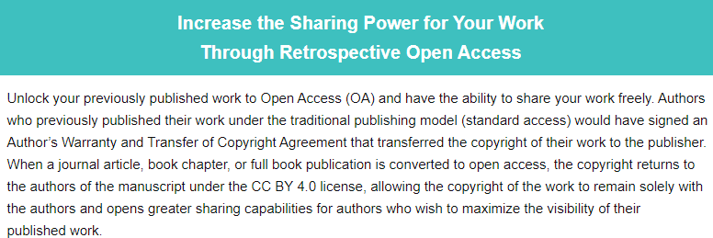

Slide 22
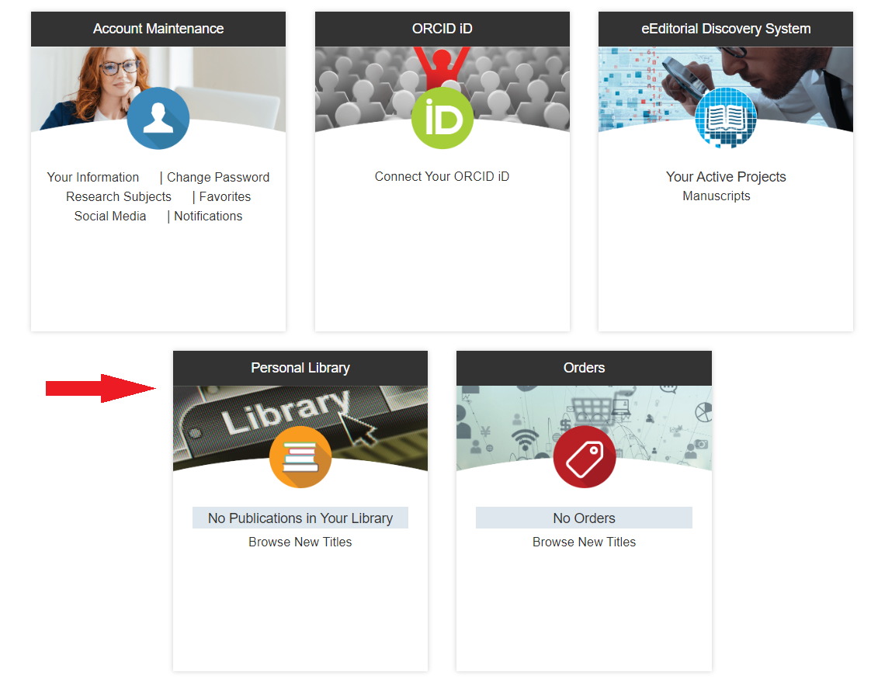
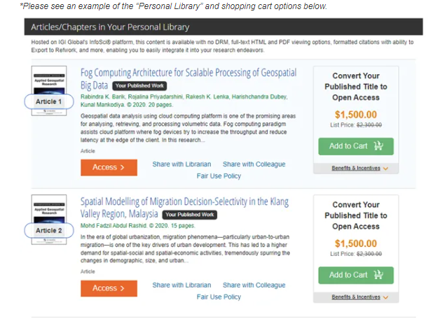
Once in the personal library, you can select the works you want to convert to OA and add them to the shopping cart
Access your previously published work through your IGI Global Portal Personal Library

Slide 23
Open Access Agreements & Transformative Options

Slide 24
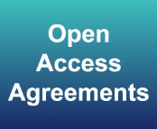
Your institution can invest an amount upfront into an OA Agreement Fund to provide their researchers with funding for APCs to simplify the process and support faculty/researchers in their endeavors. ​
​
*Discounts on APCs deducted from the fund are available based on investment amount.

Slide 25
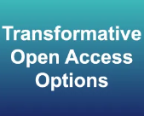
As of 2023, all IGI Global journals will convert to Gold Open Access, and the 2000-2022 content (110+ e-Journals) will still be available for purchase. ​
Invest in IGI Global e-Journal Collection backfile (archival) content, and we can work with you to convert your faculty’s published journal content to OA (CC BY 4.0 License) based on your investment.

Slide 26
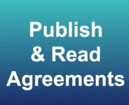
Institutions can support the Diversity, Equity, Inclusion, and Accessibility (DEI&A) Movement by providing full funding for a publication, allowing researchers to publish regardless of funding, affiliation, and geographic location..​
We can collaborate on Publish & Read Agreements in which an institution’s faculty-led full projects can be supported by the institution under Platinum Open Access (fully funded by an outside source). These options can provide access to e-Collection content at no additional cost beyond the OA support.

Slide 27
Full Open Access Book Publishing with IGI Global
Through the University of North Texas’s investment in IGI Global e-Collections, they were able to support publishing the Handbook of Research on the Global View of Open Access and Scholarly Communications under Platinum Open Access (OA).​
This collaboration is the first of its kind through IGI Global to result in a full platinum OA reference book that was fully supported, provided the ability to receive flexible OA support, increased accessibility of research support and inclusive OA practices, and more.​

Slide 28
Questions?

Slide 29
Contact Us
Marissa Massare, Open Access Publishing Coordinator, IGI Global
mmassare@igi-global.com
Brittany Haynes, Director of
e-Collections, IGI Global
bhaynes@igi-global.com
eResources
eresources@igi-global.com
Open Access
openaccessadmin@igi-global.com

